Slide 1
Ulwazi mayelana nezindlela zokuvikela iHIV ongakhetha kuzo

Slide 2
Izindlela zokuvikela iHIV ongakhetha kuzo
Ziningi izinto ongazenza ukunciphisa ubungozi beHIV kuwena nophathina wakho.
Abeluleki bafuna ukukusiza ukuthi uqonde zonke lezindlela ezilandelayo zokuvikela iHIV ukuze ukhethe ukuthi iziphi izindlela ezizokusebenzela kangcono:

Slide 3
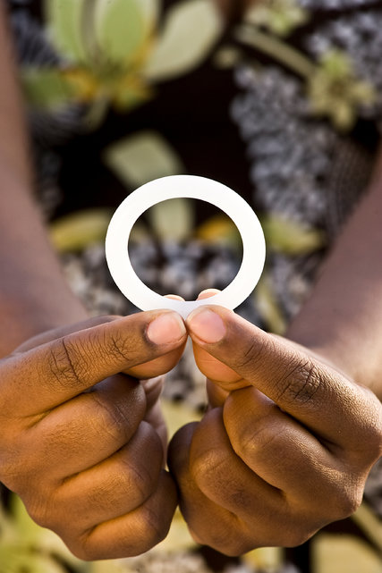
Ucwaningo lukhombise ukuthi iringi yedapivirine yesitho sowesifazane sangasese sangaphambili inganciphisa amathuba okutheleleka kwabesifazane ngeHIV. Ukuvikeleka ekuthelelekeni ngeHIV kubasezingeni eliphakeme kakhulu uma iringi isetshenziswa zikhathi zonke.
Sebenzisa iringi yedapivirine yesitho sowesifazane sangasese sangaphambili ngasosonke isikhathi

Slide 4
Sebenzisa amakhondomu
ngasosonke isikhathi
Sebenzisa ikhondomu ngendlela okuyiyo ngasosonke isikhathi uma wenza ucansi lwesitho sangasese sangaphambili sowesifazane, olwesitho sangasese sangemuva kanye nolomlomo.
Notes:
Bheka ingemuva lalelipheshana ngolwazi olwengeziwe ngamakhondomu.

Slide 5
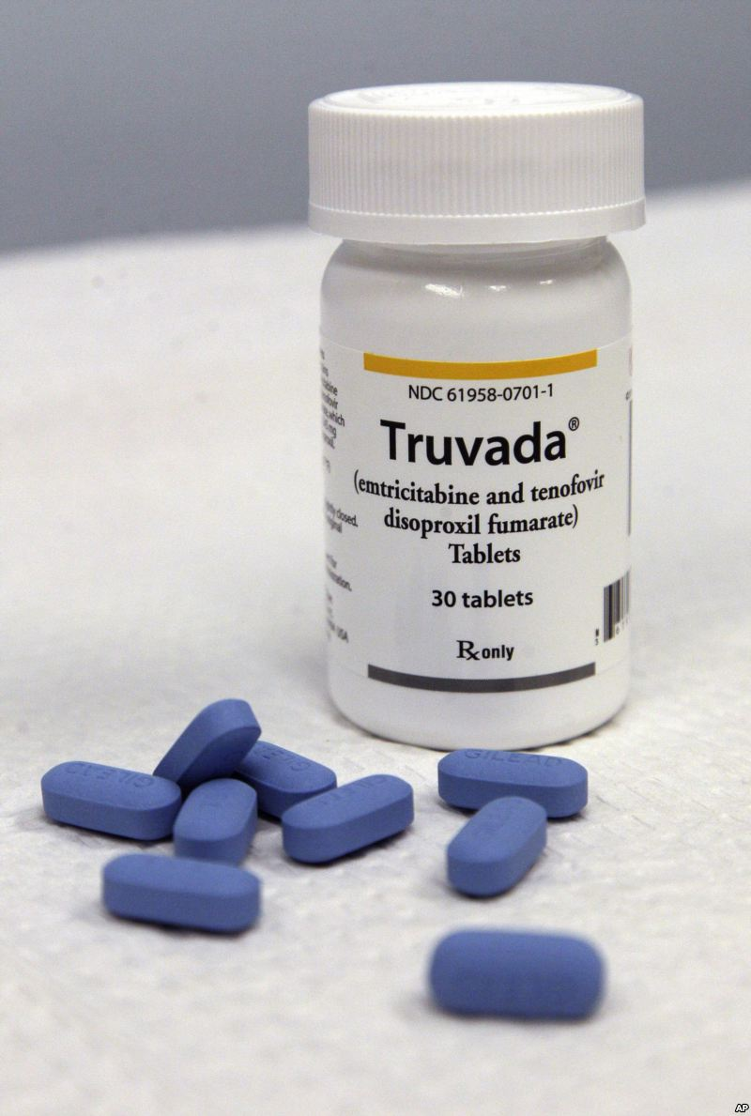
Sebenzisa iPrEP ephuzwayo (e.g. Truvada)
I-PrEP ephuzwayo iyindlela yokuvikela iHIV engakhethwa abantu abangenayo iHIV kodwa abasengcupheni enkulu yokutheleleka ngeHIV.
I-PrEP ephuzwayo ibandakanya ukuthatha imishanguzo ethize yeHIV zonke izinsuku.
I-PrEP ephuzwayo ingatholakala noma ingangatholakala emphakathini wakho.
Notes:
Uma kuzwakala njengendlela ongathanda ukuyisebenzisa, khuluma nabasebenzi baseklinikhi ngokuthi isiyatholakala yini endaweni yangakini.

Slide 6
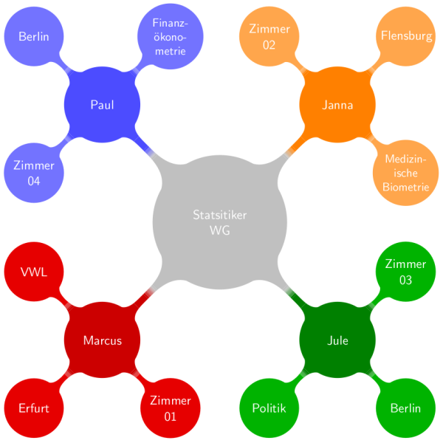
Nciphisa isibalo sakho
sophathina bocansi
Notes:
Uma uba nophathina abaningi, kwenza abe maningi amathuba okuthi ube nophathina one HIV. Uma uphathina wakho enophathina abaningi, mugqugquzele naye ukuthi anciphise lesisibalo futhi. Kuzokwehlisa ubungozi bokutheleleka ngeHIV kunina nonke.

Slide 7
Zibandakanye ekuziphatheni kwezocansi okunobungozi obuphansi
Ucansi lomlomo lunobungozi obuphansi kakhulu kunocansi lwesitho sangasese sangaphambili sowesifazane noma ucansi lwesitho sangasese sangemuva.
Abantu abaningi bacabanga ukuthi ucansi lwesitho sangasese sangemuva luyindlela ephephile abangayikhetha, kodwa empeleni kuwuhlobo locansi elunobungozi kakhulu ekudluliseleni iHIV.

Slide 8
Uma unesifo socansi esithelelanayo (STI), thola ukwelashwa
Ukuba nesifo socansi esithelelanayo kungakhuphula ubungozi bokutheleleka ngeHIV noma ukulisabalalisa kwabanye. Gcizelela ukuthi ophathina bakho bahlolwe futhi belashwe nabo.

Slide 9
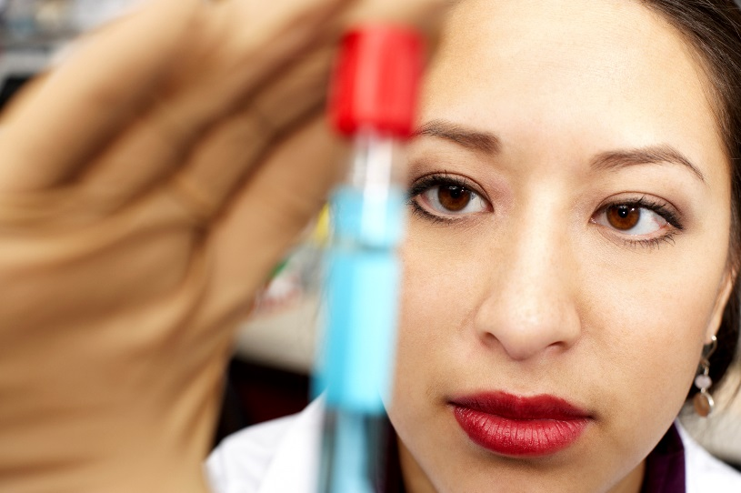
Gqugquzela uphathina wakho ukuthi ahlolelwe iHIV
Khuluma nophathina wakho ngokuhlolela iHIV bese niyahlolwa ngaphambi kokuba nenze ucansi.
Ukwazi ukuthi uphathina wakho uneHIV kungakusiza ukuba unqume ukuthi iziphi izindlela zokuvikela ezingase zikusebenzele kangcono.

Slide 10
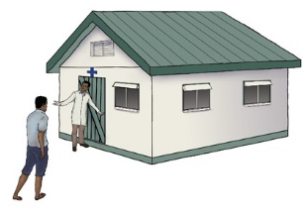
Gqugquzela uphathina wakho
ukuthi ayosokwa
Abesilisa abasokiwe basethubeni eliwuhhafu kunabesilisa abangasokiwe ukuthola igciwane lesandulela ngculazi.
Ukusokwa kwabesilisa akubavikeli abesifazane ekutholeni iHIV.

Slide 11
Uma uphathina wakho eneHIV, mugqugquzele ukuthi asebenzise imishanguzo yakhe yeHIV
ngendlela ayalelwe ngayo
Notes:
Ukwelashwa ngemishanguzo yeHIV (ebizwa ngama antiretroviral therapy noma kafushane ART) kusiza abantu abaneHIV ukuthi baphile isikhathi eside, nokuphila ngendlela enempilo. Ama-ART awakwelaphi ukutheleleka ngeHIV, kodwa anganciphisa inani leHIV emzimbeni. Ukuba neHIV kancane emzimbeni kunciphisa ubungozi bukaphathina wakho ekudluliseni iHIV ngesikhathi kwenziwa ucansi.

Slide 12
Nakuba zonke izindlela zingeke zikwazi ukwenzeka kubobonke abesifazane, ukwanda kwalezinto ongazenza, ukwanda kokuncipha kwethuba lokuthola iHIV.
Izindlela zokuvikela iHIV ongakhetha kuzo

Slide 13
Ulwazi olwengeziwe mayelana namakhondomu:
Amakhondomu avikela ungatheleleki ngeHIV ngokocansi lwesitho sowesifazane sangasese sangaphimbili kanye nocansi lwesitho sangasese sangemuva.
Iringi-yedapivirine inciphisa ubungozi bokuthola iHIV ngocansi lwesitho sangasese sangaphambili sowesifazane.
Iringi ayakhelwanga ukuvikela ekuthelelekeni ngeHIV ngocansi lwesitho sangasese sangemuva futhi akufanele isetshenziswe esithweni sangasese sangemuva.

Slide 14
Ulwazi olwengeziwe mayelana namakhondomu:
Amakhondomu avikela ukukhulelwa kanye nezinye izifo ezithelelana ngokocansi.
Notes:
Ngaphezu kokuvikela kwiHIV, amakhondomu anezinye izinzuzo zezempilo. Amanye izithandani akhetha amakhondomu njengendlela yokuhlela umndeni ukuvikela ukukhulelwa okungahlosiwe.

Slide 15
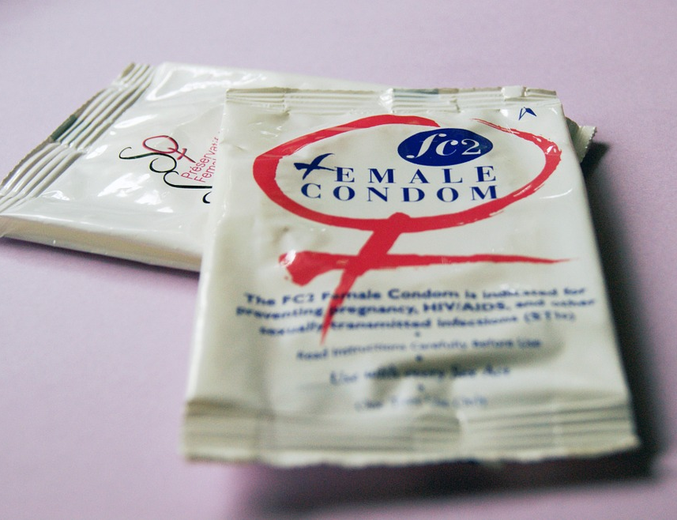
Ulwazi olwengeziwe mayelana namakhondomu:
Uma esetshenziswa njalo ngendlela, amakhondomu e-latex ayindlela engcono kakhulu kuvikela kwezinye izifo ezithelelana ngokocansi njenge gonorrhoea, chlamydia, noma trichomonas.
Notes:
Anciphisa futhi ubungozi bezifo zezilonda zesitho sangasese, njenge iherpes yesitho sangasese, syphilis, kanye ne-chancroid, uma indawo ethelelekile noma indawo enethuba lokutheleleka ivikelekile. Anganciphisa ubungozi bokutheleleka nge-human papillomavirus (HPV) kanye nezifo ezihlangene ne-HPV (e.g., izinsumpa zesitho sangasese kanye nomdlavuza wesibeletho).

Slide 16
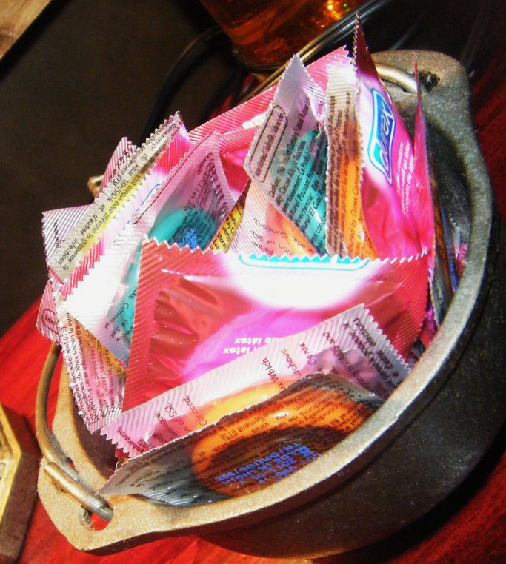
Angasetshenziswa kanjani ngendlela nangezikhathi zonke amakhondomu:
Sebenzisa ikhondomu entsha ngesenzo ngasinye socansi (lomlomo, lwesitho sangasese sowesifazane sangaphambili kanye nolwesitho sangasese sangemuva).

Slide 17
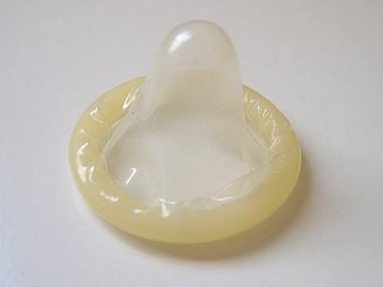
Angasetshenziswa kanjani ngendlela nangezikhathi zonke amakhondomu:
Liphathe kahle ikhondomu ukugwema ukulilimaza ngezinzipho, amazinyo, kanye nezinye izinto ezicijile.
Faka ikhondomu emva kokuba isitho sangasese sangaphambili sowesilisa sesivukelwe nangaphambi kwanoma ikuphi ukuthintana ngezitho zangasese, umlomo, noma isitho sangasese sangemuva nophathina wakho.

Slide 18
Angasetshenziswa kanjani ngendlela nangezikhathi zonke amakhondomu:
Qinisekisa ukuthi ubumanzi banele ngesikhathi wenza ucansi lwesitho sowesifazane sangasese sangaphambili kanye nocansi lwesitho sangasese sangemuva, kodwa sebenzisa isithambisi esinesisekelo samanzi (njenge K-Y Jelly) kanye namakhondomu e-latex.
Izithambisi ezinesisekelo samafutha (njengoVaseline noma iloshini yomzimba) kungawalimaza amakhondomu.

Slide 19
Angasetshenziswa kanjani ngendlela nangezikhathi zonke amakhondomu:
Ukugwema ikhondomu ukuthi lishibilike liphume, libambe liqine emsukweni wesitho sowesilisa sangasese sangaphambili ngesikhathi ukhipha, bese ukhipha isitho sowesilsa sangasese sangaphambili ngesikhathi sesivukelwe.

Slide 20
Uma unemibuzo noma udinga ulwazi olwengeziwe, sicela uvakashele eklinikhi yocwaningo.

